Slide 1
INNOVATION FEST ‘23 DEATH TIME PREDICTION OF DECEASED
LAZY MOB
MOHANKUMAR S [7376211EC218]
JEEVIKA S [7376211EC174]

Slide 2
PROBLEM STATEMENT
The main problem with today’s autopsy procedure is high cost, time consumption, usage of manual power. Other than that, it has often been unable to avoid technological problems in cases of anomalous fatalities, including deletion of evidence.
We may blame this on lack of technologies and the ability to access.
Even though all problems cannot be eradicated, some could be made easier with the help of existing data, collection and processing of it by using Machine Learning could prove useful, easy and helps avoid the manual mistakes.

Slide 3
IDEA DETAILS
A traditional mortis procedure involving fundamental autopsy methods, like as
Pallor mortis (paleness of skin),
Algor mortis (temperature change),
rigor mortis (body muscle stiffening) and
livor mortis (purplish-red discoloration due to gravitational pooling of blood to the lower dependent parts).

Slide 4
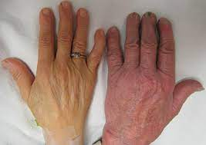
PALLOR MORTIS
The onset and duration of pallor mortis can be affected by various factors such as the individual's skin color, the cause of death, and the environmental conditions (ambient temperature).
For example, individuals with lighter skin tones will generally show a more noticeable pallor mortis than those with darker skin tones.
The examination of pallor mortis is carried out using computer vision technology in open CV and machine learning.

Slide 5
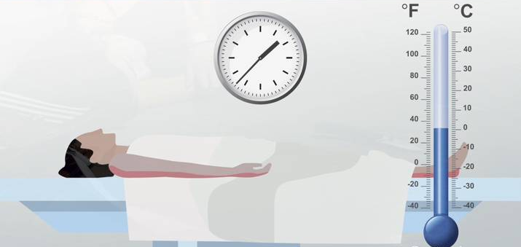
ALGOR MORTIS
The rate of cooling can be affected by various factors such as the body's size and insulation, the ambient temperature and humidity, and the body's initial temperature at the time of death. For example, larger bodies and those with more insulation will cool more slowly, while a warmer initial temperature or a warmer surrounding environment will cause the body to cool more quickly.
The estimation of time of death using algor mortis is often less reliable than other methods, such as rigor mortis and livor mortis, because it can be affected by so many variables.
the analysis of algor mortis is done using the analysis of both the internal and external body temperatures.

Slide 6
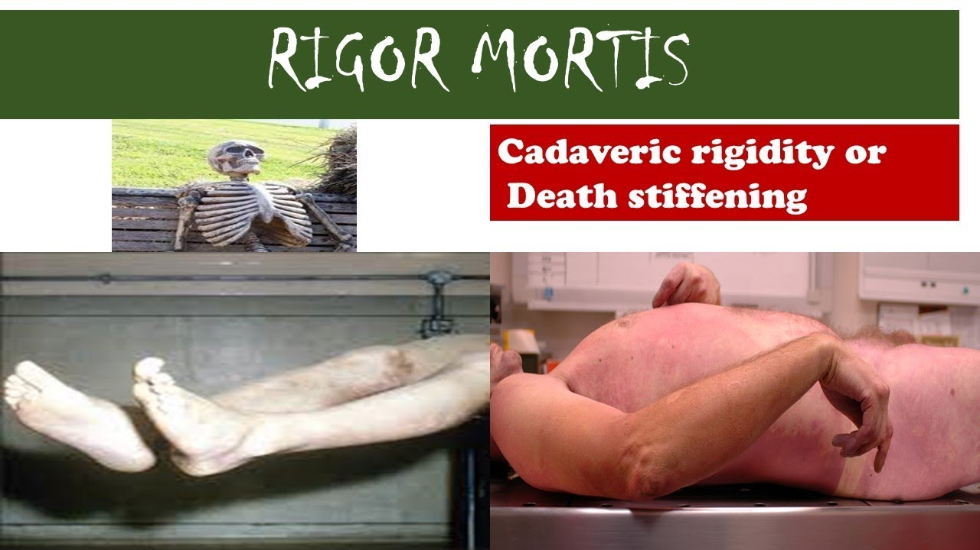
RIGOR MORTIS
Muscle stiffening which starts to occur within 1-2 hours after death or as late as 12 hours or more a few hours after death and reaches its maximum stiffness around 12-24 hours after death. The onset and duration of rigor mortis can vary depending on various factors such as the temperature of the environment, the individual's physical condition, and the type of muscle involved.
Rigor mortis typically lasts for a few hours to several days, after which the muscles gradually relax and return to their normal state. The exact duration depends on the same factors that influence its onset. In general, rigor mortis sets in faster and is more intense at higher temperatures and in more muscular individuals.
The data for rigor mortis is gathered from X-ray diffraction

Slide 7
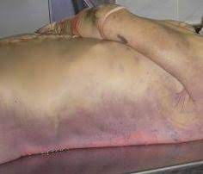
LIVOR MORTIS
The onset and duration of livor mortis can be affected by various factors such as the individual's position at the time of death, the cause of death, and the condition of the body. Livor mortis can be most prominent in the lower parts of the body, such as the buttocks, legs, and back, in individuals who have been lying in a supine position for an extended period of time.
In contrast, if an individual dies in an upright position, the livor mortis can be most pronounced in the dependent parts of the body, such as the feet and lower legs. Livor mortis typically reaches its maximum intensity between 8-12 hours after death and can persist for up to 24-36 hours.
The examination of livor mortis is carried out using image identification.

Slide 8
THE WORK WE DO:
This initiative intends to streamline the process so that it can forecast the time of death rapidly and effortlessly.
With information based on previously records, data on the time of death is gathered, and a predictive model is built using which the tool will be able to estimate the time of death by examining at the mortis components each time a corpse is examined.
In conclusion, a rapid analysis system can be employed to do an autopsy without the necessity for the time-consuming procedures that are usually required.

Slide 9
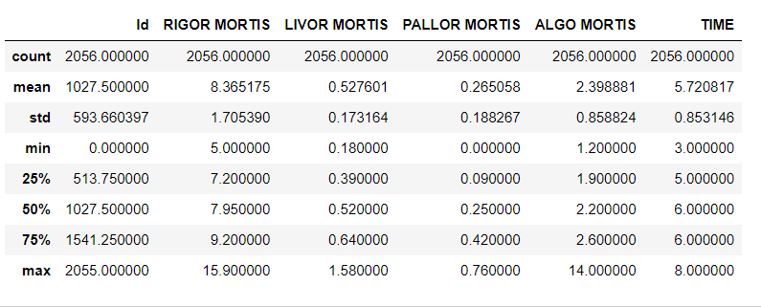
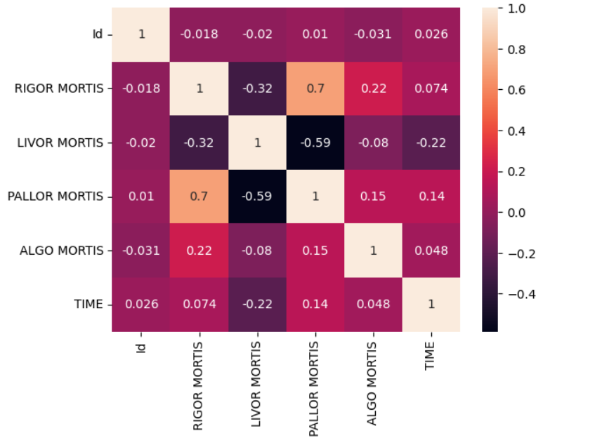
DESIGN AND IMPLEMENTATION
ALL THE ABOVE MENTIONED DETAILS ARE COLLECTED FOR THE CORPSE AND FED INTO OUR MACHINE LEARNING MODEL
The model is trained in different aspects of rigor mortis, livor mortis, pallor mortis and algo mortis.

Slide 10
DESIGN AND IMPLEMENTATION
PALLOR MORTIS
ALGOR MORTIS
LIVOR MORTIS
OPENCV
COLOR SENSOR
SENSOR
OPENCV
TEMPERATURE
RASPBERRY PI 4
X-RAY
RIGOR MORTIS
DIFFRACTION
MACHINE LEARNING MODEL
OUTPUT

Slide 11
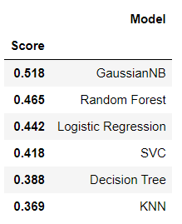
DEPENDENCIES
The main problems behind the development of this project is
Identification of livor mortis
Identification of pallor mortis
Accuracy of the model

Slide 12
Use case and Business Model
The system mainly focuses on making the work easy for medical and forensic professionals that carry of autopsy.
A typical post mortem procedure costs approximately up-to 5000 INR and increases momentarily based on the complexity of the procedure thereby making it economically unavailable.
The profit is obtained mainly due to reduction of man power and complexity of procedures. The usage of imaging data, X-ray diffraction, deduction of internal and external temperature.

Slide 13
Thank You

